Slide 1
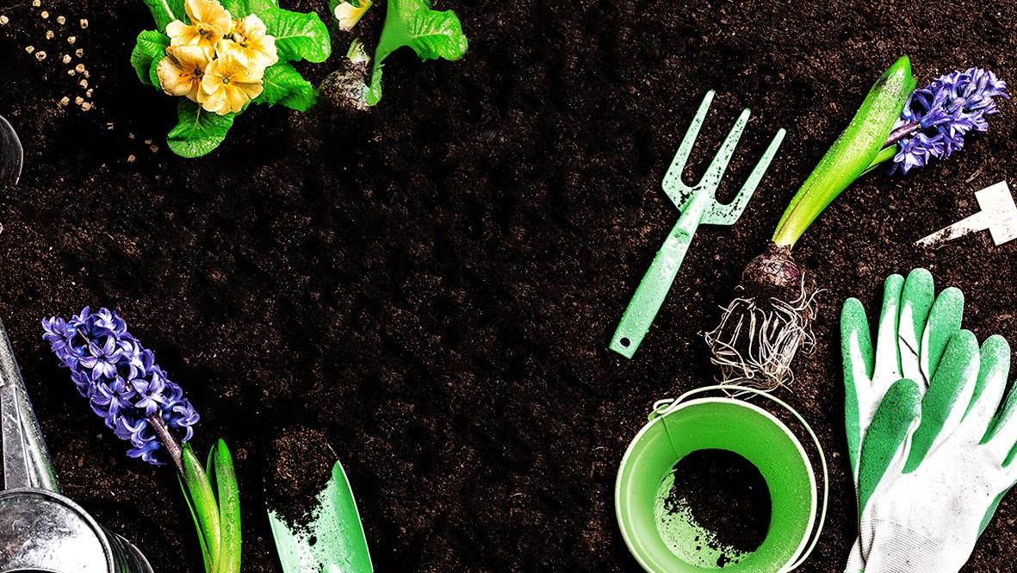
Gardening
Algorithm Capstone
Team members:
Kasha Muzila
Karl Eirich
Robert Turnage
Cynthia Zhu
Notes:
Present: 13 min
QnA: 2 min

Slide 2
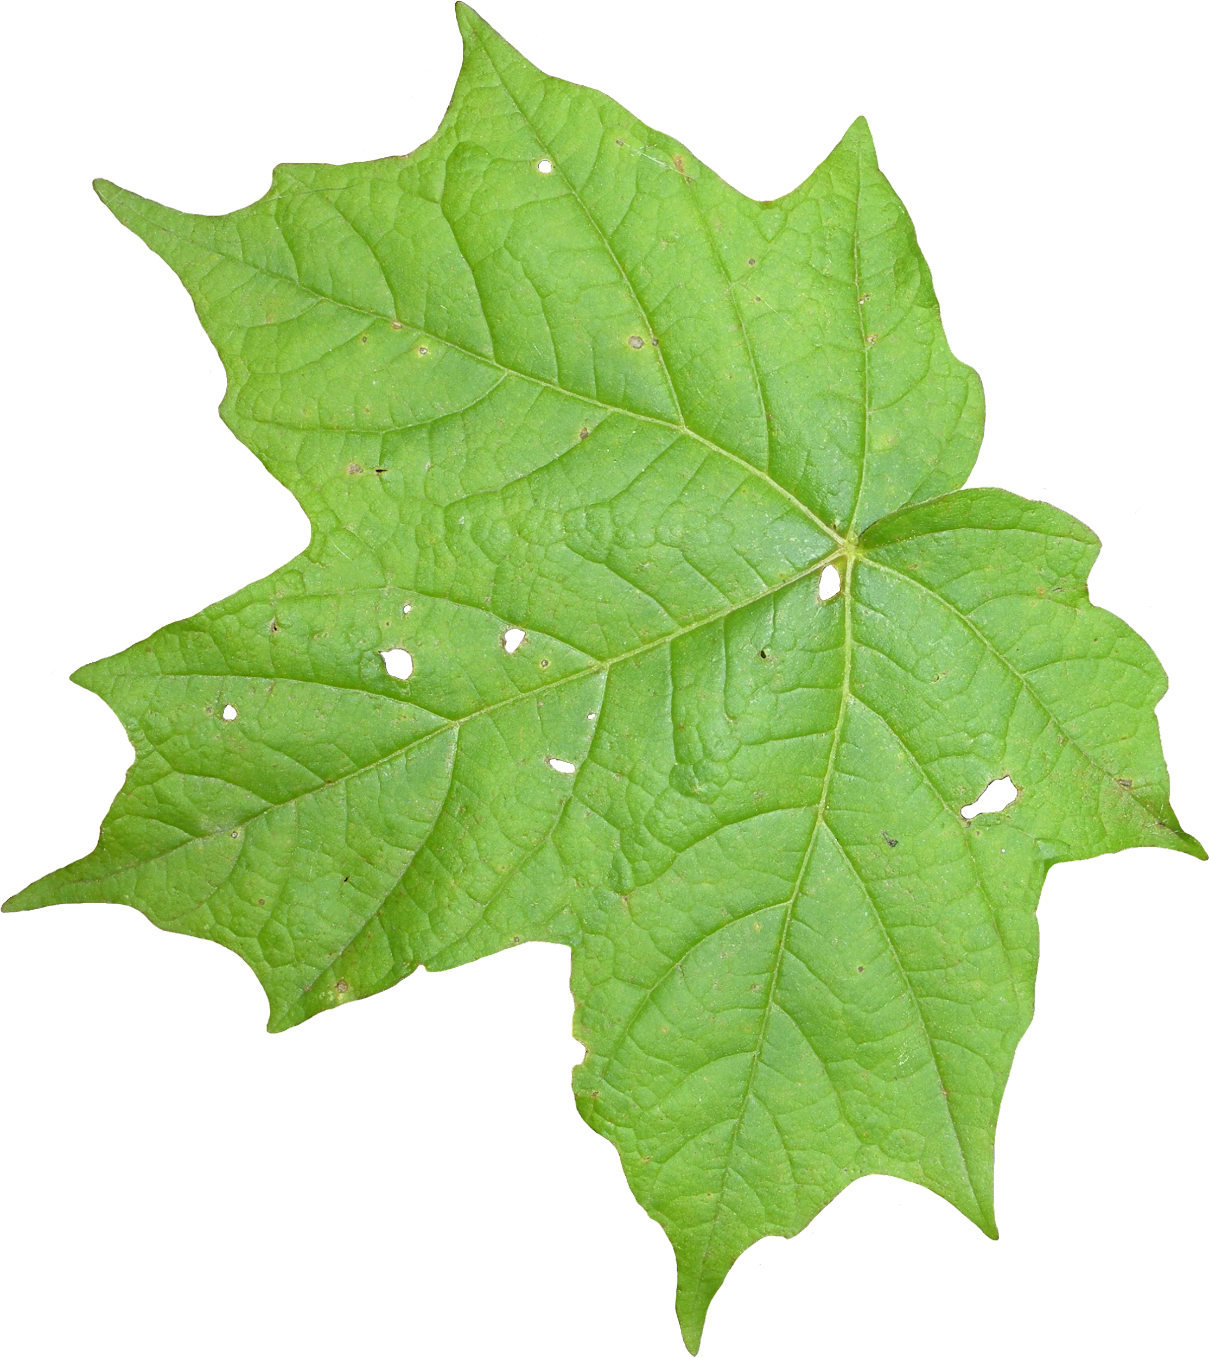

Overview
Robert
Green Thumb AI is a website and mobile app that can suggest what to plant in a hobby garden based on the number of sun hours, zone, time of year, the direction your garden is facing, and frost dates.
Additionally, the learning curve for beginner gardeners is so high that many are too afraid to start. This app would be able to simplify the learning curve into smaller chunks so beginners can purchase and learn about the plants that they can plant right now instead of all plants from every season. For more advanced gardeners, this would make budgeting more efficient as they can see what they can plant based on their initial preferences and can price compare before investing.
All of this would help enable gardeners of varying skills and knowledge to save time and money.
Notes:
Robert (30s)
5-10% -- overview of the customer / user problem you are solving and why it is an important problem to solve -- market opportunity, pervasiveness of the problem, impact if your solution is implemented. (you should have nailed this part). Anyone and everyone should immediately understand why you are building what you are building. Strong and clear motivation to the problem.

Slide 3

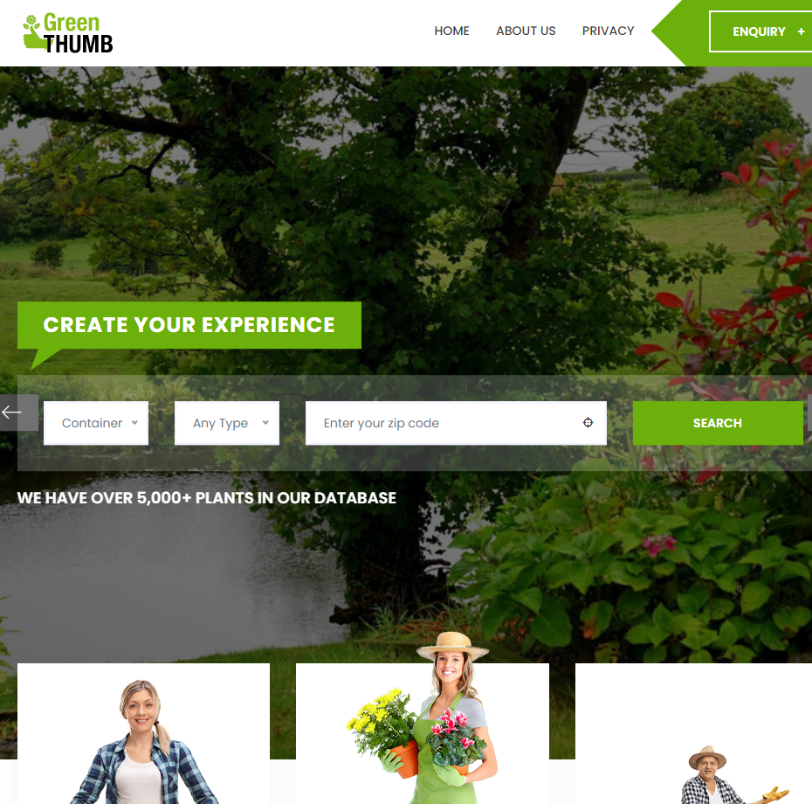
Robert
Having a compliant form factor for user usage on web 2.x or Mobile platforms.
Design is aligned to the stories in scope for three gardener types Veggies-t, Aesthetics-t, Hybrid-ers.
Still to come,... the design for user inputs that drive the model and the usage of outputs. Dependent on what we can achieve in time…
GreenThumb.ai | Homepage http://20.127.87.137
Notes:
Robert (1m)
10-15% -- describe the MVP and key features that directly relate back to the problem for the target user. Discuss, through the MVP, why your solution is differentiated. Put your product manager hat on. Anyone and everyone should understand what you are building, why the MVP makes sense and is compelling, and what impact your product will have on the initial set of end users or customers. What work is in progress to gain validation from your target user.

Slide 4
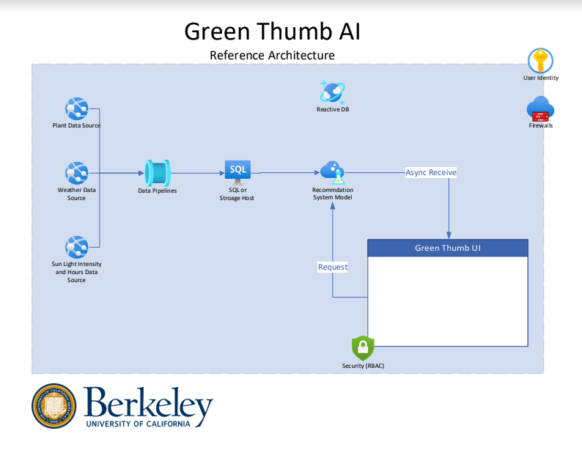

Architecture
Robert
This is a simple diagram showing our reference architecture.
Data ingestion via pipelines in python 3x. Clean and initial transformation. Final transformation and data science recommendation system pairing with MLOps on Cloud Machine Learning Platform (AML)
Notes:
Robert (30s)
60%- 70% -- technical discussion. For example: summarize data pipeline (30 sec), overall architecture (1 min), discuss model(s) and technique(s) in compelling details so that the audience (class) understand what you are building “under the hood” and why. Show and discuss the data science techniques used, how exactly you are applying the techniques in your project, challenges, trade-offs, current results. Put your CTO, data architect, data engineer, and data scientist hats on.

Slide 5







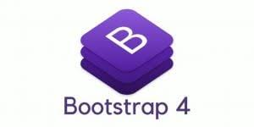

App Engineering
Robert
We are using HTML5, CSS3, JS (Bootstrap, React): Hosted on Azure VM Ubuntu 20.04 LTS
Using in Python 3.x Flask 2.x
With the logic for the data science model trained and hosted on Azure Machine Learning
Notes:
Robert (30s)
We are using HTML5, CSS3, JS (Bootstrap, React): Hosted in Python Flask on an Azure VM Ubuntu 20.04 LTS
With the logic for the data science model trained and hosted on Azure Machine Learning

Slide 6
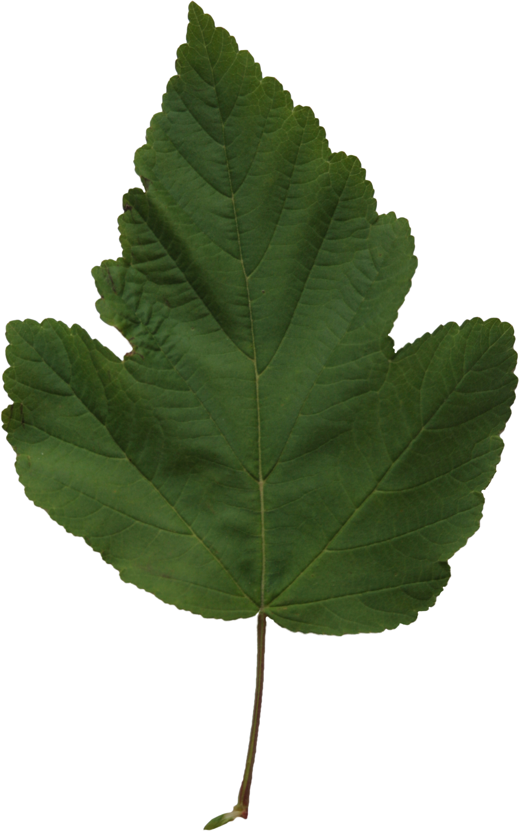
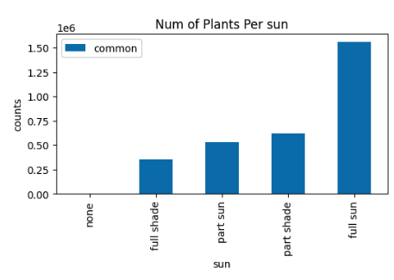
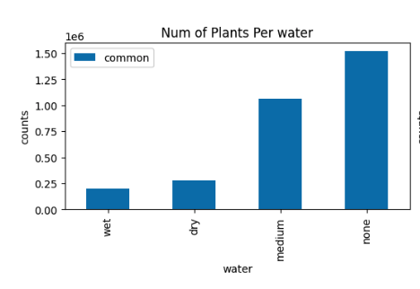
Data Engineering
Karl
Data normalization was done to increase join compatibility
The process was very manual but provided the granular control needed to align value formats
Columns were dropped that did not see data parity across other tables
Values were aggregated to prioritize the join without compromising the signal
Notes:
Karl (1m)

Slide 7
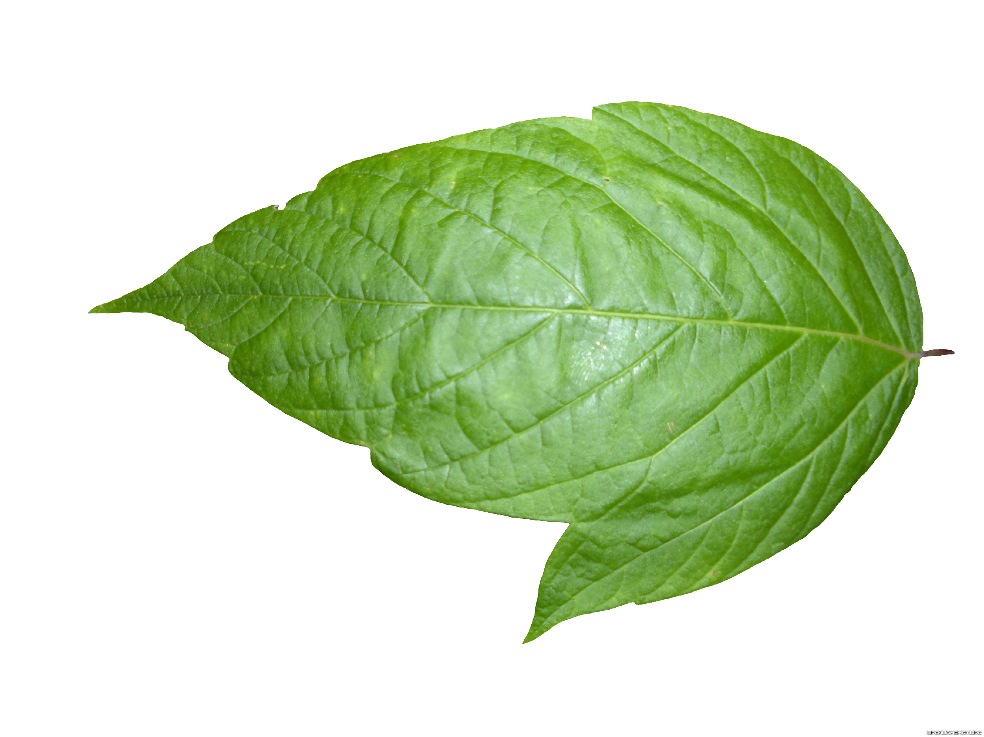
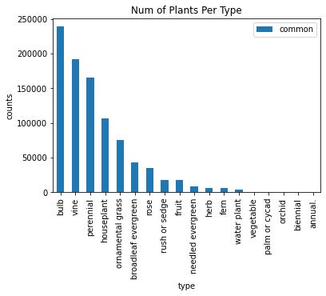
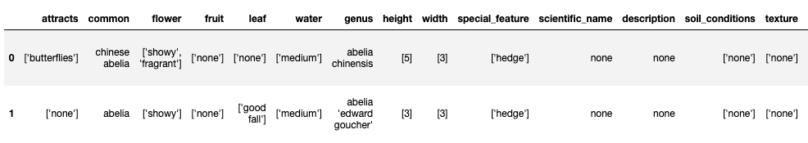
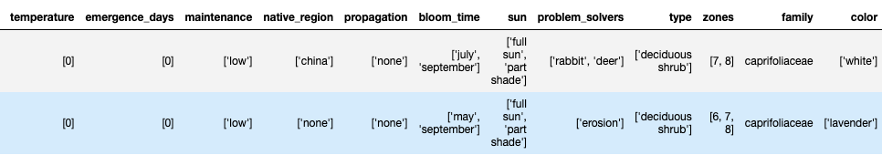
EDA - plants
Cynthia
Total plants: 3244, if excluding shrub/tree, 1143.
All Features: 25 features
-'attracts', 'flower', 'fruit', 'leaf', 'water', 'genus', 'height', 'width', 'special_feature', 'scientific_name', 'description', 'soil_conditions', 'texture', 'emergence_days', 'maintenance', 'native_region', 'propagation', 'bloom_time', 'sun', 'problem_solvers', 'type', 'zones', 'family', 'color', 'temp_bucket'
Feature Engineering:
Explode each category of feature into a separate record
Bucketize temperature to match the lookup table
Type of plants
Check features distribution
10 Features have >50% none value: Attracts, flower, fruit, leaf, scientific_name, description, soil_conditions, texture, native_region, emergence_days
Notes:
Cynthia (2m)

Slide 8
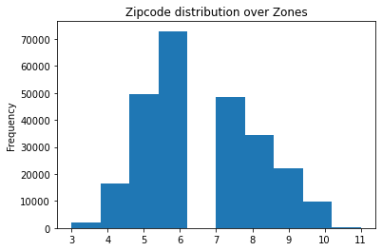
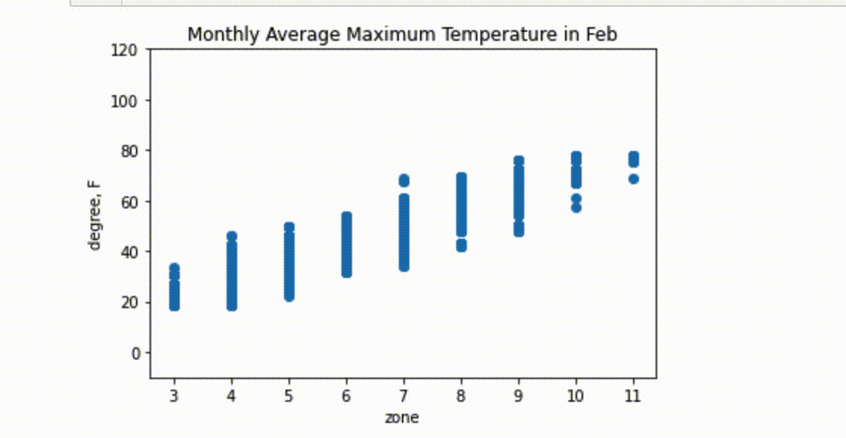
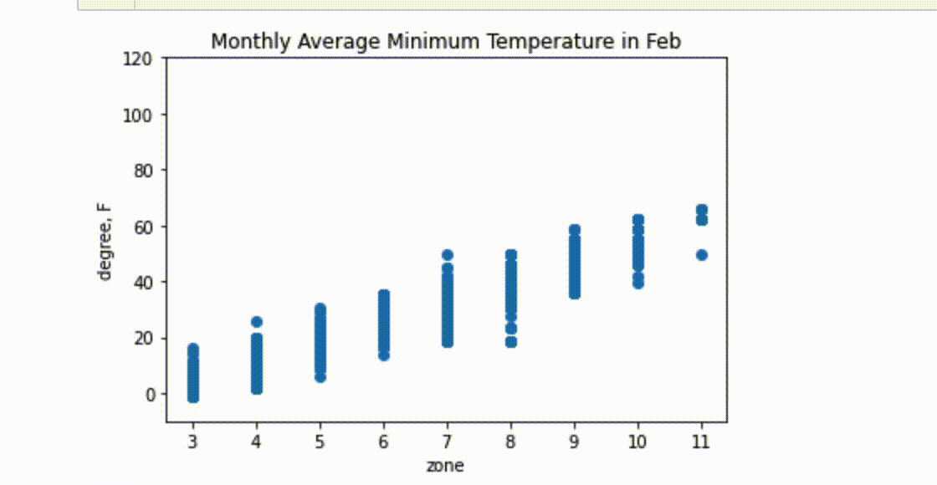
EDA - location-based weather dataset
Cynthia
Joined weather with planting zone by closest geospatial coordinates
210 cities with 2017-2020 temperature vs 21K zip code with designated planting zone → most of zip codes will share the same weather features
Zone has a relative normal distribution across US.
Zone correlates with temperature over Jan - Dec
Notes:
Cynthia (2m)

Slide 9
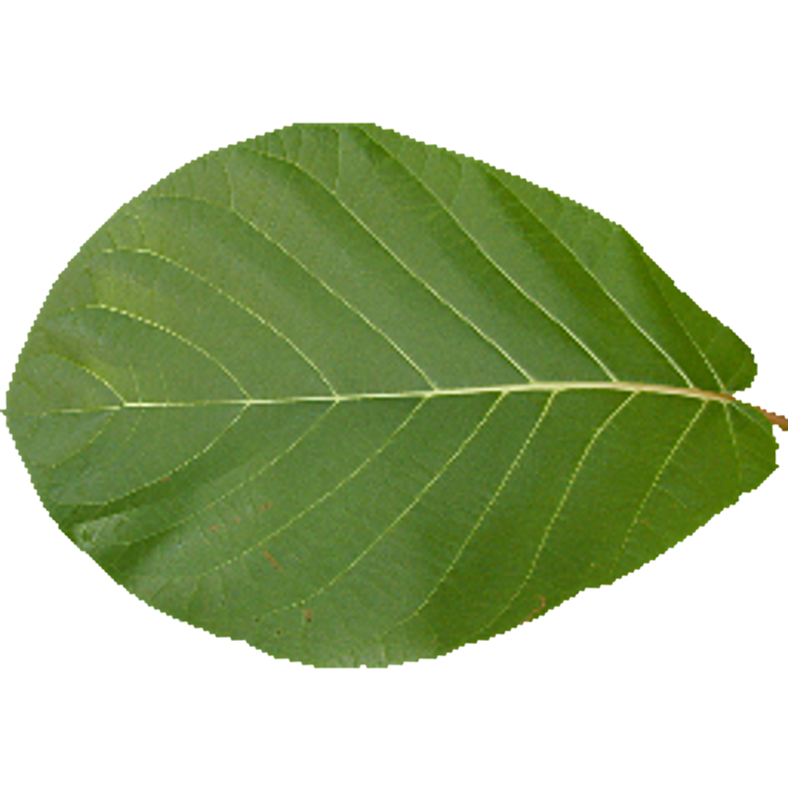
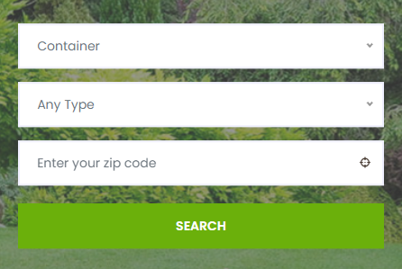

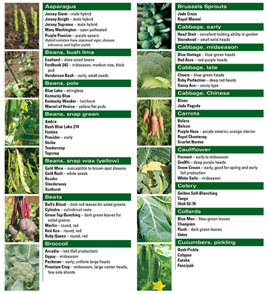
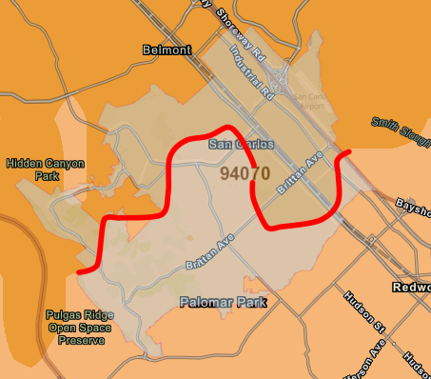


Model
Kasha
1. Filter Plant Dataset Using Zip Code
2. Use DS Model to Recommend Best Plants to Grow
10a
Filter
9b
Notes:
Kasha (30s) Updates on data science model, metrics, features, etc.

Slide 10
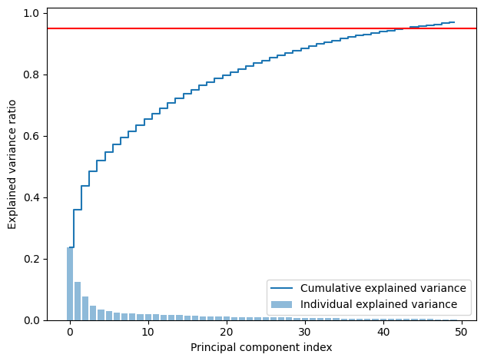
Model
Cynthia
Given the user’s zip code, we find zone, sunhour, temp_bucket based on tmax and tmin → subset plant data that meet above criteria
Remove the features have >50% null value
PCA and selected cutoff at 95% explained ratio
Modeling:
DBSCAN to select optimum number of clusters → all -1 label, no proper cluster found
KMeans, gridsearch give k=300 with silhouette score of 0.18.
Notes:
Cynthia (1m)

Slide 11
Data Privacy Consideration Overview
Team Name: Green Thumb AI Description: Algorithm that suggests recommendations for what to plant in the small garden based on initial environmental conditions.
Kasha
Data Privacy Consideration | In-Scope for Capstone Project to address. Actions: | Out-Scope for Capstone Project to address. Possible solution:
FTC Principles circa 2012 | Data Collection (Zip Code). We do not persist this data and we do not aggregate or persist with IP tracing or tracking. Data Usage is within the session state and is ephemeral. | Security considerations, should be designed and implemented for production. Current state of system can implement B2C/B2B RBAC and identity management for AuthN/AuthZ requirements.
CALOPPA | There is no tracking via web or mobile. Azure platform is used for hosting in the cloud Data Privacy in the Trusted Cloud | Microsoft Azure | (BCOM) PCI-DSSv3 will not be enabled in this feasbillity version, but is a consideration for production ready edition.
Notes:
Kasha(1m)
Include the data privacy consideration slide (template will be distributed). List considerations for your project and provide clear but succinct information about how you addressed privacy considerations in-scope for Capstone, and note those that will be out of scope.

Slide 12

Next Steps
Karl
Allow user to select one plant for item-based recommender approach
Usage terms and disclosure of responsibility. Invasive species considerations in design.
Host the model(s) in Azure Machine Learning and connect to Flask App
Notes:
Karl (30s)
10% - 20% -- discuss the remaining major work / roadmap of the project, project management for the remainder of the semester, help needed, and wrap up with a strong closing summarizing the mission of the project.

Slide 13

docker-compose exec kafka \
kafka-console-consumer \
--bootstrap-server kafka:29092 \
--topic foo \
--from-beginning \
--max-messages 42
Karl
Thank
You

